Slide 1
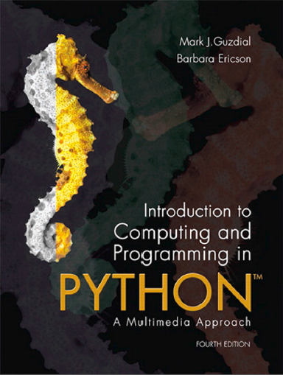
Introduction to Computing and Programming in Python™: A Multimedia Approach
Fourth Edition
Chapter 5
Picture Techniques with Selection v2
Copyright © 2016, 2013, 2010 Pearson Education, Inc. All Rights Reserved
Notes:
If this PowerPoint presentation contains mathematical equations, you may need to check that your computer has the following installed:
1) MathType Plugin
2) Math Player (free versions available)
3) NVDA Reader (free versions available)

Slide 2
Learning Objectives
5.1 To implement controlled color changes, like red-eye removal, sepia tones, and posterizing.
5.2 To use background subtraction to separate foreground from background images and to understand when and how it will work.
5.3 To use chromakey to separate foreground from background images.
5.4 To draw lines and borders based on position.
5.5 To use conditionals to select certain pixels.
5.6 To use if, else, and elif.

Slide 3
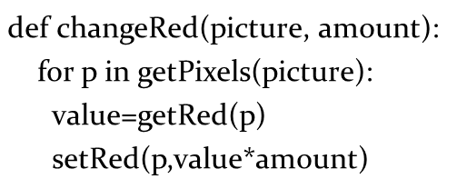
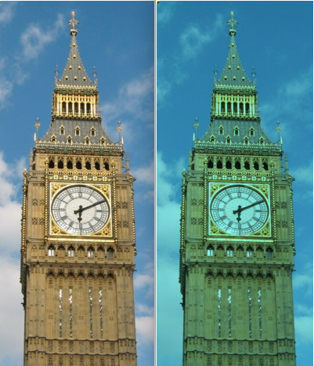
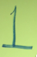

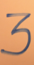
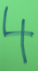
I Want to Make a ChangeRed Function That Will Let Me
If “b” is the Big Ben picture, which of the below did this →
changeRed(b,1.5)
changeRed(b,2.0)
changeRed(b,0)
changeRed(b,0.5)
Notes:
#4
#4

Slide 4
Distance Between Colors?
Sometimes you need to, e.g., when deciding if something is a “close enough” match
How do we measure distance?
Pretend it’s cartesian coordinate system
Distance between two points:
Distance between two colors:

Slide 5
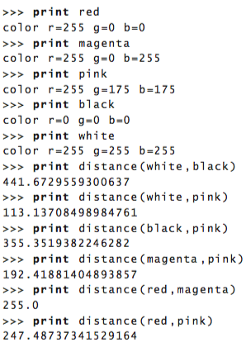
Trying distance left parenthesis right parenthesis

Slide 6
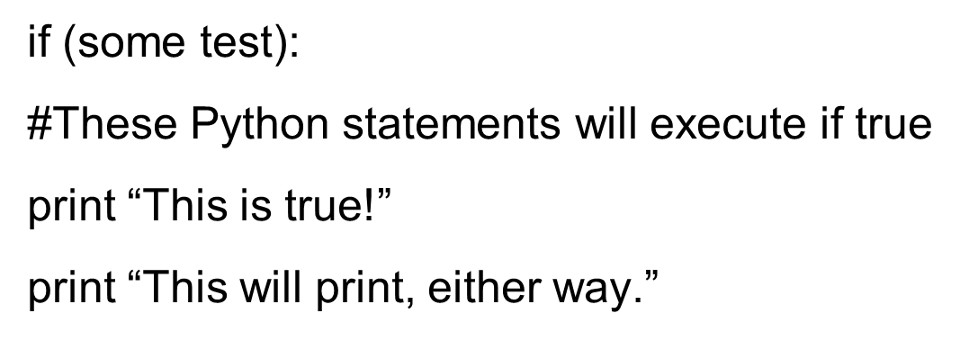
Introducing I F
Computers can make choices.
They can perform tests.
Then execute different statements depending on the result of the test.

Slide 7
Tuning Our Color Replacement
If you want to get more of Barb’s hair, just increasing the threshold doesn’t work
Wood behind becomes within the threshold value
How could we do it better?
Lower our threshold, but then miss some of the hair
Work only within a range…

Slide 8
Computing a Distance Between Colors
What does it mean for a color to be “close” to another color?
We will compute a color distance, based on the formula for the distance between two points.

Slide 9
Replacing Colors Using I F
We don’t have to do one-to-one changes or replacements of color
We can use if to decide if we want to make a change.
We could look for a range of colors, or one specific color.
We could use an operation (like multiplication) to set the new color, or we can set it to a specific value.
It all depends on the effect that we want.

Slide 10
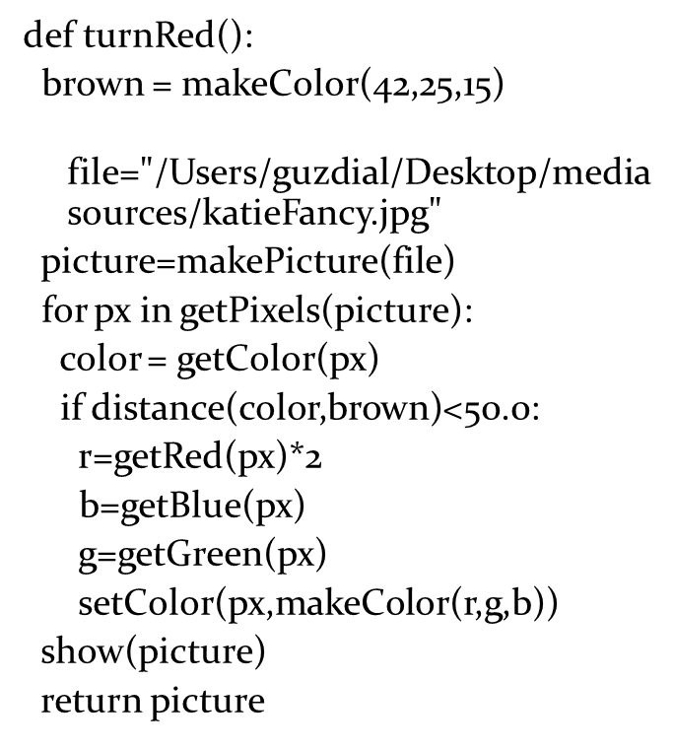
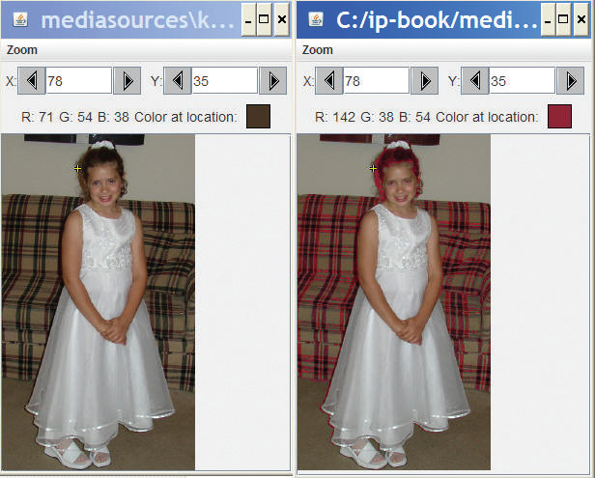
Working on Katie’s Hair
This version doubles all “close” reds. Notice the couch.

Slide 11
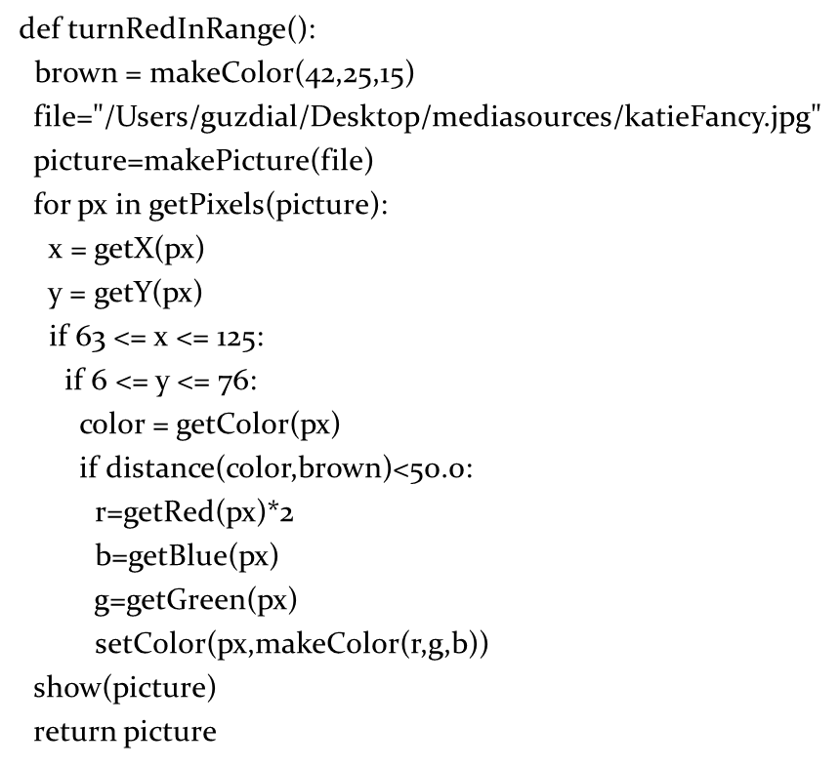
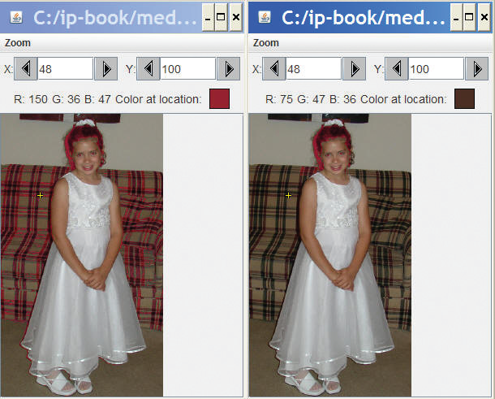
Working on Katie’s Hair, in a Range
Left is one we did with all “close” browns. Right is same, but only in rect around head.

Slide 12
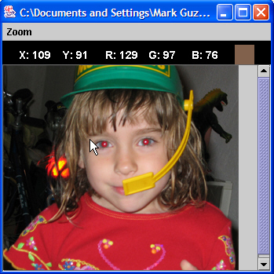
Removing “Red Eye”
When the flash of the camera catches the eye just right (especially with light colored eyes), we get bounce back from the back of the retina.
This results in “red eye”
We can replace the “red” with a color of our choosing.
First, we figure out where the eyes are (x,y) using MediaTools

Slide 13
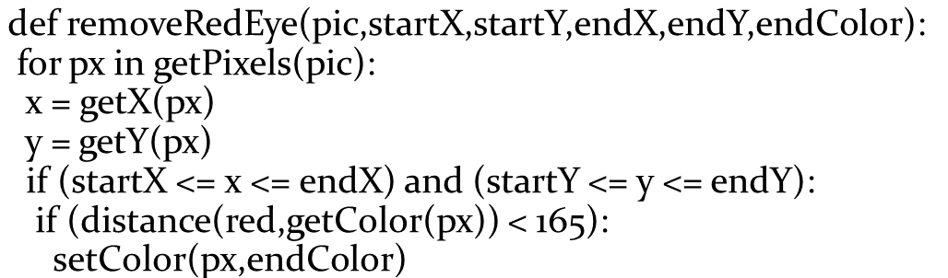
Removing Red Eye
What we’re doing here:
Within the rectangle of pixels (startX,startY) to (endX, endY)
Find pixels close to red, then replace them with a new color
Why use a range? Because we don’t want to replace her red dress!

Slide 14
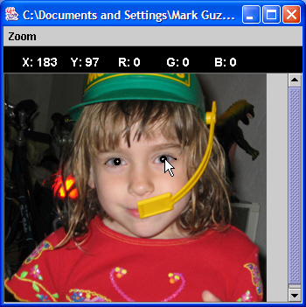
“Fixing” it: Changing Red to Black
removeRedEye(jenny, 109, 91, 202, 107, makeColor(0,0,0))
Jenny’s eyes are actually not black—could fix that
Eye are also not mono-color
A better function would handle gradations of red and replace with gradations of the right eye color

Slide 15
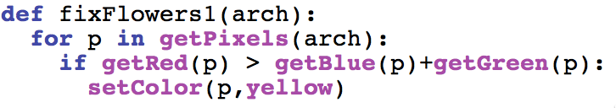
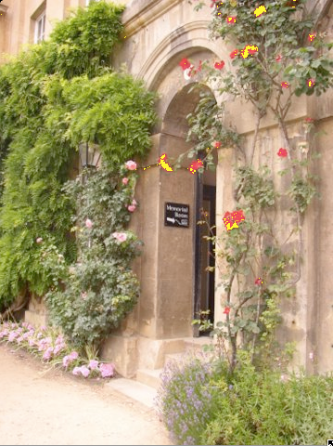
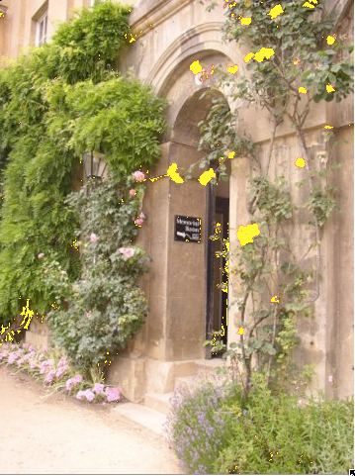
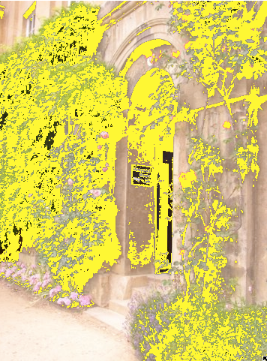
Consider This Program (1 of 7)
Which picture below did this generate?
Notes:
#2
#2

Slide 16
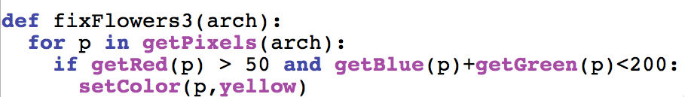
Consider This Program (2 of 7)
Which picture below did this generate?
Notes:
#3
#2

Slide 17
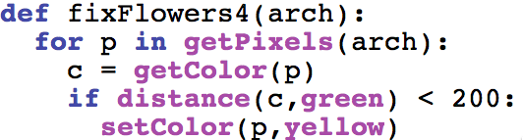
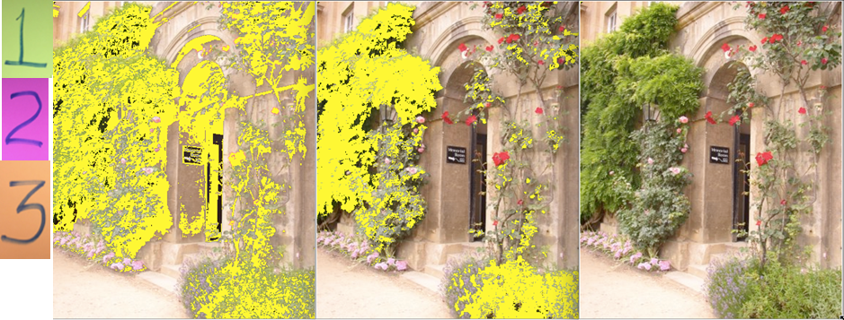
Consider This Program (3 of 7)
Which picture below did this generate ?
Notes:
#2
#2

Slide 18
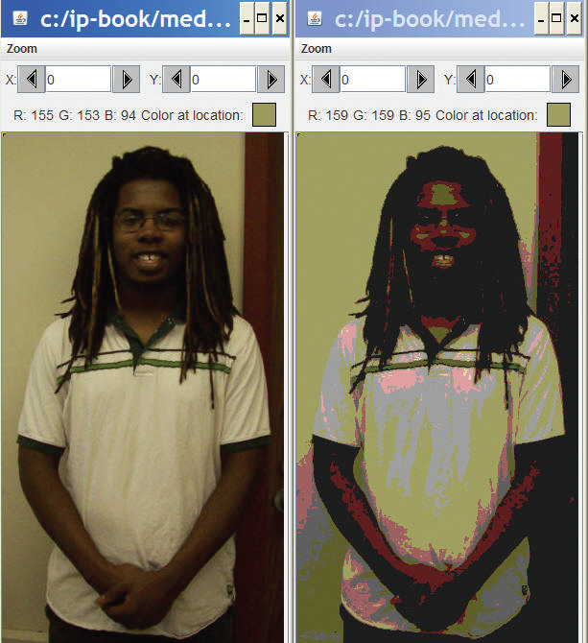
Posterizing: Reducing Range of Colors

Slide 19
Posterizing: How we do it
We look for a range of colors, then map them to a single color.
If red is between 63 and 128, set it to 95
If green is less than 64, set it to 31
...
It requires a lot of if statements, but it's really pretty simple.
The end result is that a bunch of different colors, get set to a few colors.

Slide 20
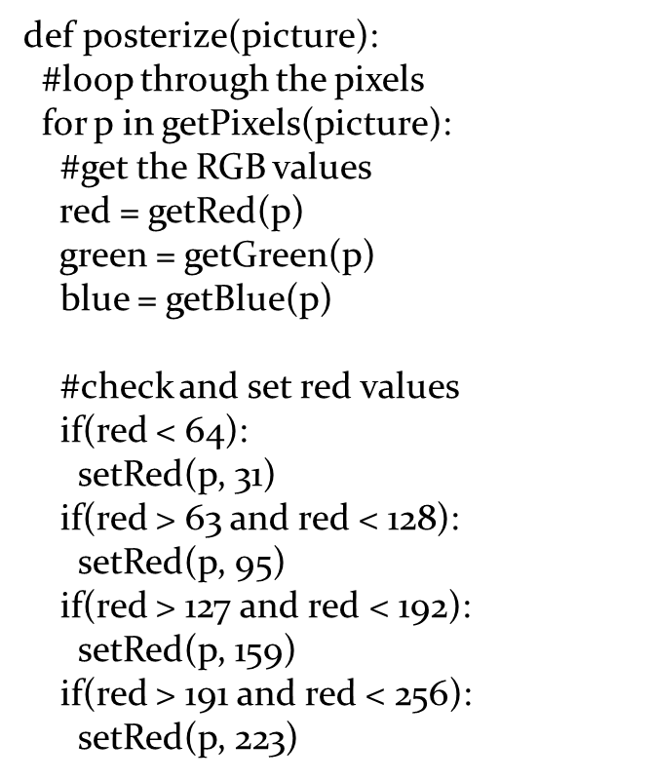
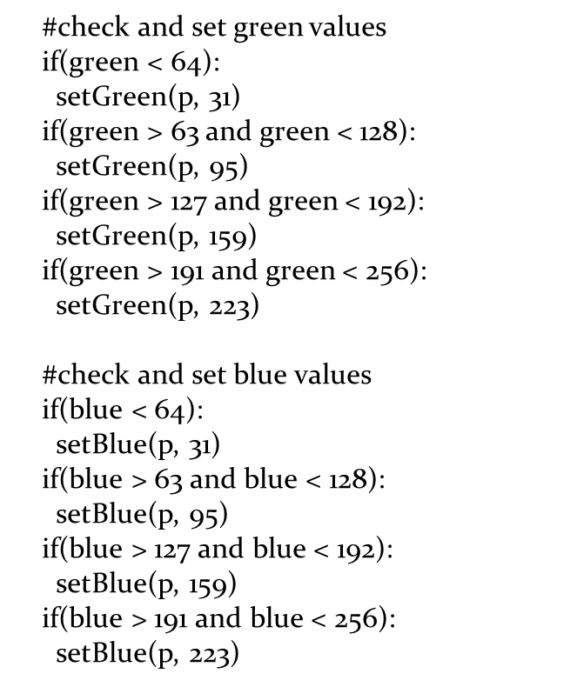
Posterizing Function

Slide 21
What’s with this “#” Stuff?
Any line that starts with a “#” is ignored by Python.
This allows you to insert comments: Notes to yourself (or another programmer) that explains what’s going on here.
When programs get longer, there are lots of pieces to them, and it's hard to figure out what each piece does.
Comments can help.

Slide 22
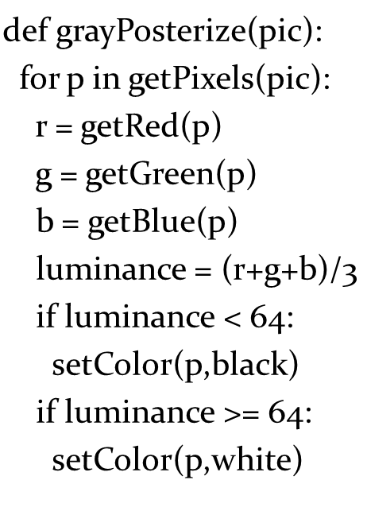
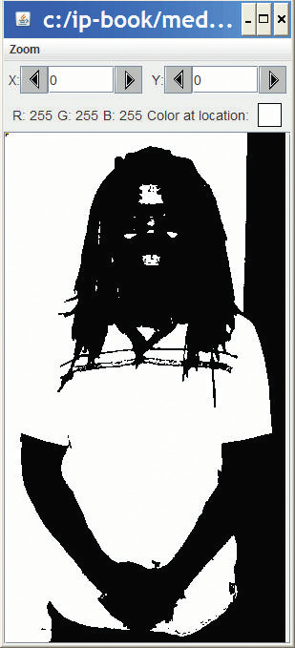
Posterizing to b/w Levels
We check luminance on each pixel.
If it’s low enough, it’s black, and Otherwise, it’s white

Slide 23
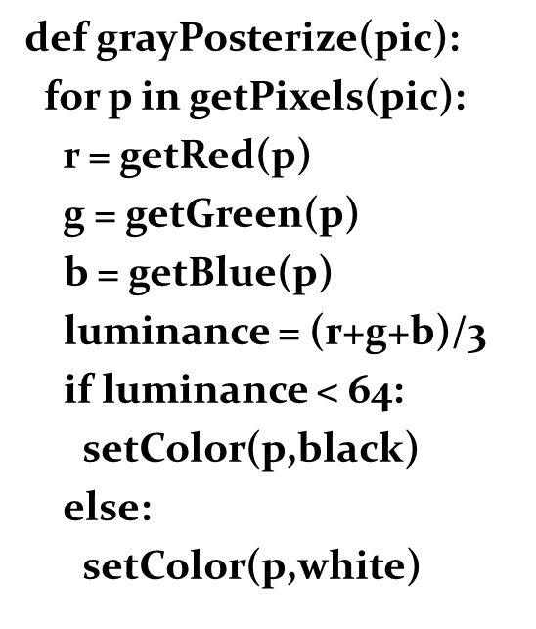
Another Way to Do That
We don’t have to do both tests. We can just say else
It’s easier to write, and it’s more efficient.
But it can be harder to read, especially for new programmers.

Slide 24
Generating Sepia-Toned Prints
Pictures that are sepia-toned have a yellowish tint to them that we associate with older pictures.
It’s not directly a matter of simply increasing the yellow in the picture, because it’s not a one-to-one correspondence.
Instead, colors in different ranges get mapped to other colors.
We can create such a mapping using I F

Slide 25
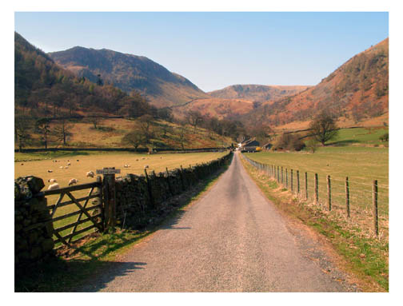
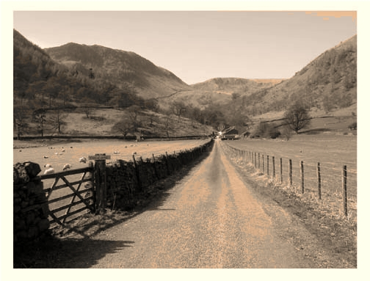
Example of Sepia-Toned Prints

Slide 26
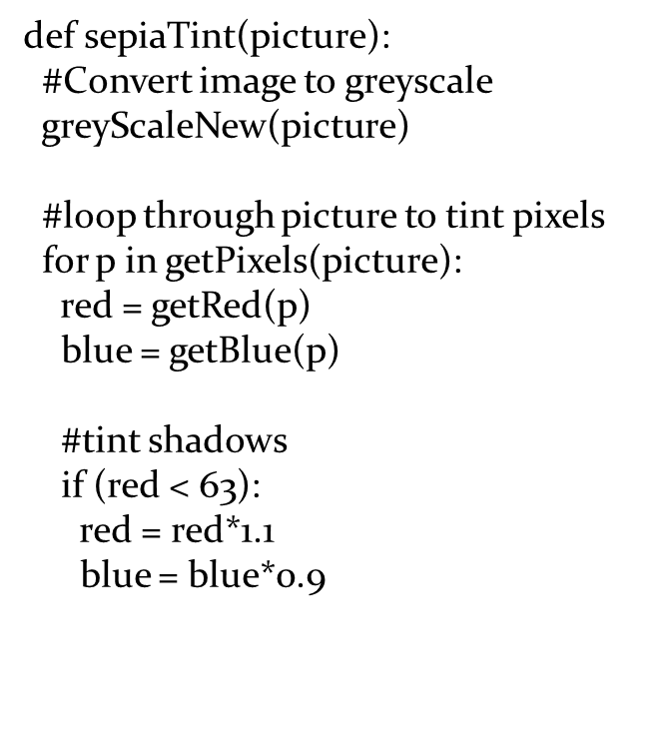
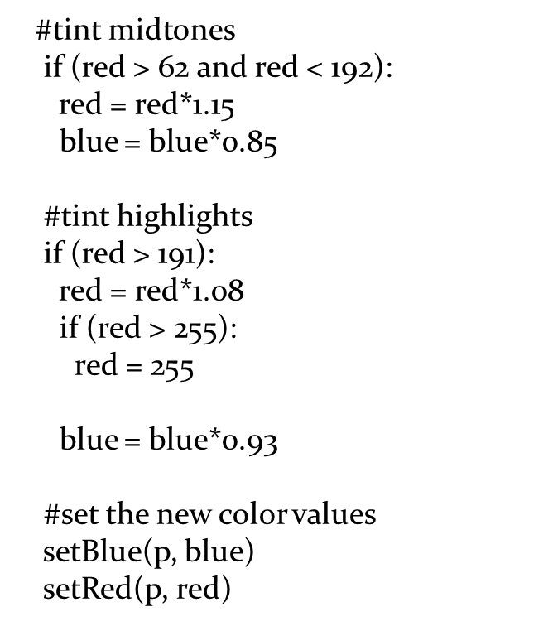
Here’s How We Do It

Slide 27
What’s Going on Here?
First, we’re calling greyScaleNew (the one with weights).
It’s perfectly okay to have one function calling another.
We then manipulate the red (increasing) and the blue (decreasing) channels to bring out more yellows and oranges.
Why are we doing the comparisons on the red? Why not? After greyscale conversion, all channels are the same!
Why these values? Trial-and-error: Twiddling the values until it looks the way that you want.

Slide 28
Edge Detection (1 of 2)
Blurring is averaging across pixels.
Edge detection is looking for differences between pixels.
We draw lines that our eyes see—where the luminance changes.
If the pixel changes left-to-right, up and down, then we make our pixel black. Else white.

Slide 29
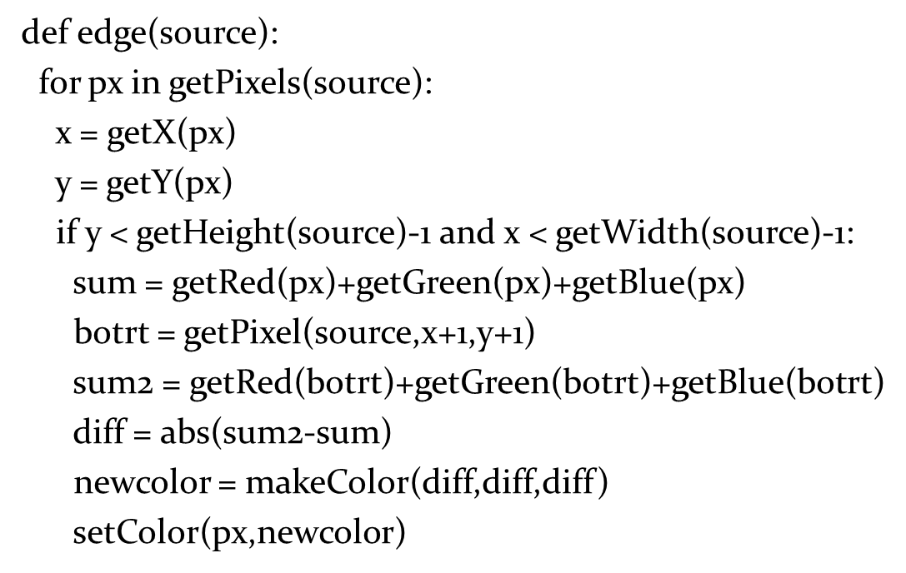
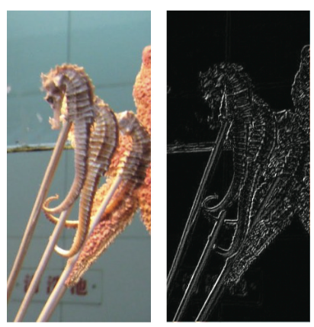
Edge Detection (2 of 2)

Slide 30
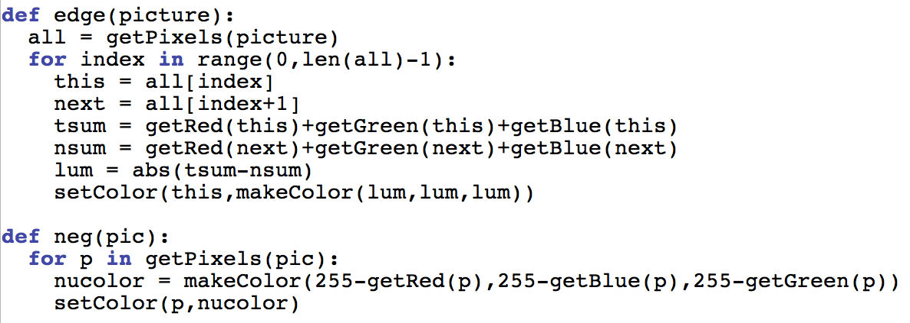
Even Simpler Edge Detection

Slide 31
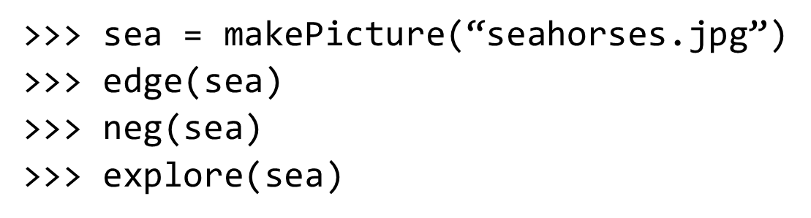
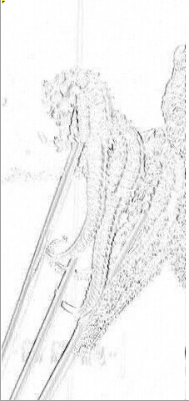
Edge Detect, Then Negate

Slide 32
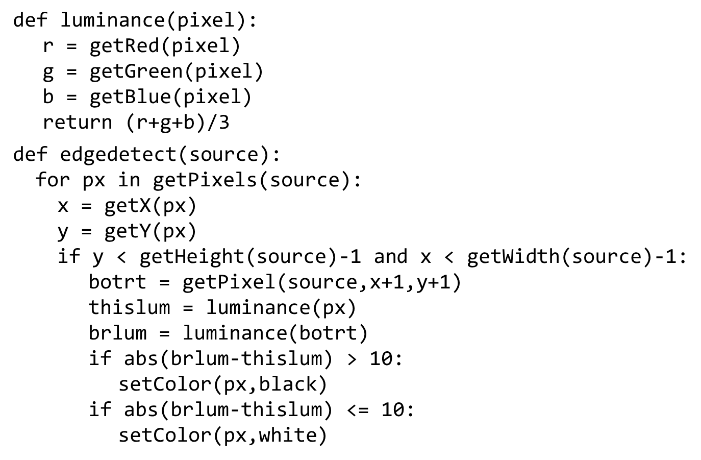
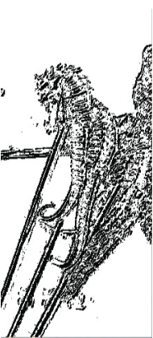
Yet Another Version

Slide 33
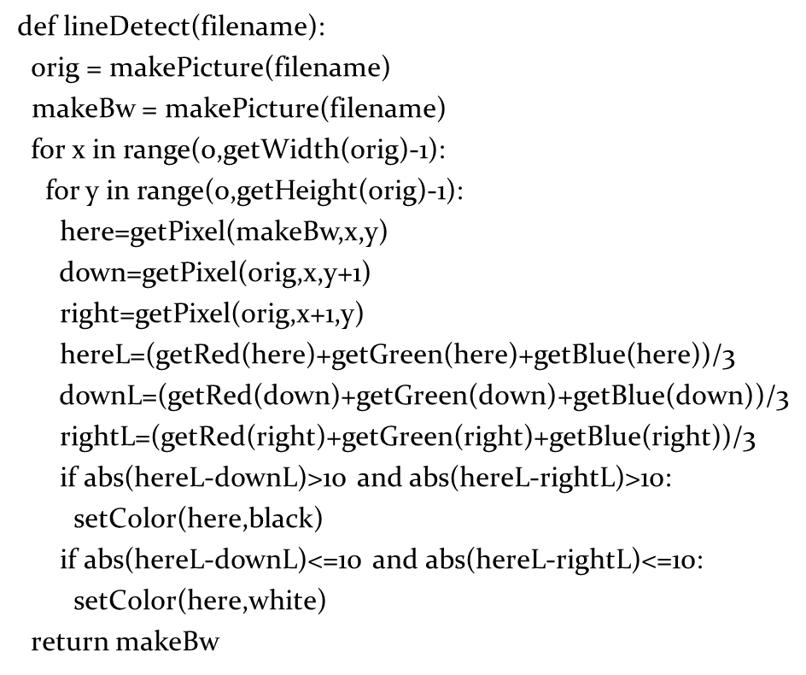
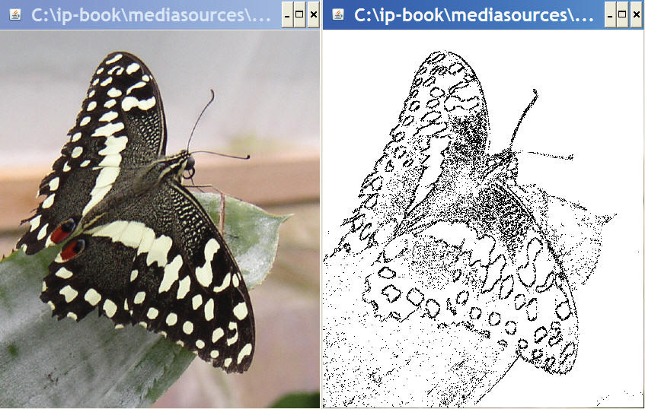
More Careful Edge Detection
Here we look in all four directions.

Slide 34
Background Subtraction
Let’s say that you have a picture of someone, and a picture of the same place (same background) without the someone there, could you subtract out the background and leave the picture of the person?
Maybe even change the background?
Let’s take that as our problem!

Slide 35
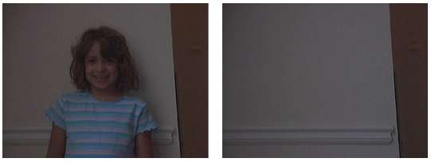
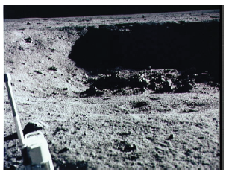
Person (Katie) and Background
Let’s put Katie on the moon!

Slide 36
Where Do We Start?
What we most need to do is to figure out whether the pixel in the Person shot is the same as the in the Background shot.
Will they be the EXACT same color? Probably not.
So, we’ll need some way of figuring out if two colors are close…

Slide 37
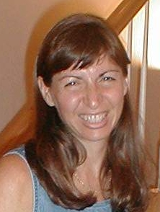
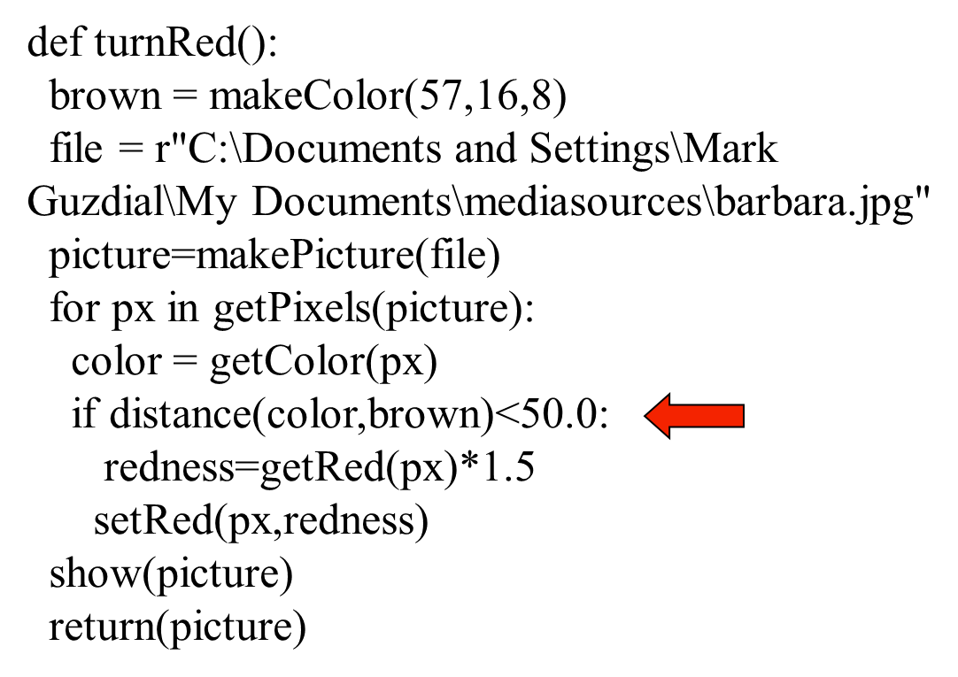
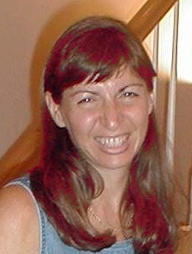
Remember this?
Original:

Slide 38
Using Distance
So we know that we want to ask:
if distance(personColor,bgColor) > someValue
And what do we then?
We want to grab the color from another background (a new background) at the same point.
Do we have any examples of doing that?

Slide 39
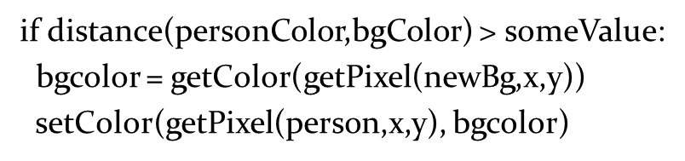
Where We are so Far:
What else do we need?
We need to get all these variables set up
We need to input a person picture, a background (background without person), and a new background.
We need a loop where x and y are the right values
We have to figure out personColor and bgColor

Slide 40
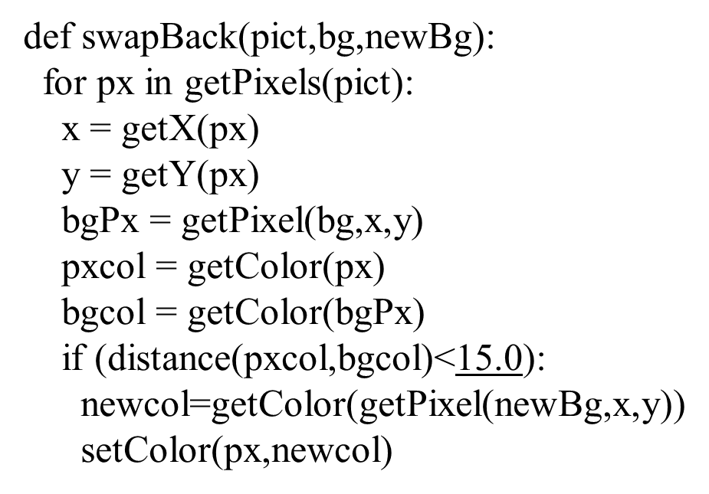
Swap a Background Using Background Subtraction
Specifying a threshold.

Slide 41
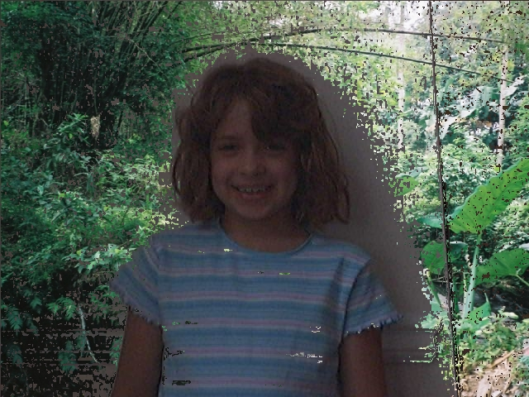
Works

Slide 42
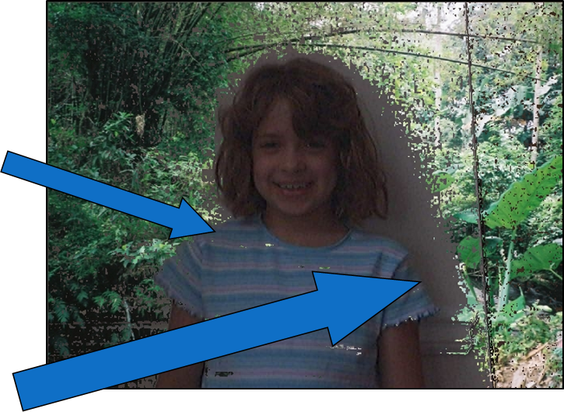
But Why isn’t it Alot Better?
We’ve got places where we got pixels swapped that we didn’t want to swap
See Katie’s shirt stripes
We’ve got places where we want pixels swapped, but didn’t get them swapped
See where Katie made a shadow

Slide 43
How Could We Make it Better?
What could we change in the program?
We could change the threshold “someValue”
If we increase it, we get fewer pixels matching
That won’t help with the shadow
If we decrease it, we get more pixels matching
That won’t help with the stripe
What could we change in the pictures?
Take them in better light, less shadow
Make sure that the person isn’t wearing clothes near the background colors.

Slide 44


We Call This Function Like This
How do we see the result?
(1) explore(kid)
(2) explore(wall)
(3) explore(jungle)
Notes:
#3
#3

Slide 45

Playing with This Program, You Generate the Above Image. What Do You Predict Changed?
(1) You made the threshold value too high so too many pixels are matching both foreground and background
(2) You made the threshold value too small so too few pixels are matching between the foreground and the background.
(3) You changed the I F so that you inverted the swap
(4) The jungle color is too close to the wall color. The moon would have worked better.
Notes:
#3
#3

Slide 46

Putting a Dog on the Moon
Figure 5.13 A dog sitting on a chair (left) and a chair without the dog (right).

Slide 47


With Different Thresholds
Figure 5.14 Putting the dog on the moon, with a threshold of 20 (left) and 50 (right).

Slide 48

Another Way: Chromakey
Have a background of a known color
Some color that won’t be on the person you want to mask out
Pure green or pure blue is most often used
I used my son’s blue bedsheet
This is how the weather people seem to be in front of a map—they’re actually in front of a blue sheet.

Slide 49

Chromakey Recipe

Slide 50


Example Results

Slide 51



Just Trying the Obvious Thing for Red

Slide 52


Doesn't Always Work as You Expect

Slide 53


Easy to do with Alice
Figure 5.19 The character Alice on a completely green background.

Slide 54

The Difference Between J P E G and P N G
Where did her shoes go?
Lossy versus. Lossless
Figure 5.20 Alice J P E G in the jungle (top) and P N G (bottom).

Slide 55
Drawing on Images
Sometimes you want to draw on pictures, to add something to the pictures.
Lines
Text
Circles and boxes.
We can do that pixel by pixel, setting black and white pixels

Slide 56





Consider This Program (4 of 7)
Which picture below did this generate?
Notes:
#1
#1

Slide 57


Drawing a Border

Slide 58

What Does This Program Do? (1 of 2)
(1) Covers a picture with green
(2) Creates a border of 10 pixels wide all green around a picture
(3) Creates a circle of green in the middle of the picture
(4) Covers a picture with a green box, inset 10 pixels on each side.
Notes:
#1
#1

Slide 59


Lightening of Picture

Slide 60

Consider This Program (5 of 7)
Which of the below is true about this program (can be more than one):
Notes:
#1 and #4
def contrast(picture):
pixels = getPixels(picture)
for i in range(0,len(pixels)):
px = pixels[i]
color = getColor(px)
if i % 2 == 0:
color = makeLighter(color)
if i % 2 == 1:
color = makeDarker(color)
setColor(px,color)
#1 and #4
def contrast(picture):
pixels = getPixels(picture)
for i in range(0,len(pixels)):
px = pixels[i]
color = getColor(px)
if i % 2 == 0:
color = makeLighter(color)
if i % 2 == 1:
color = makeDarker(color)
setColor(px,color)

Slide 61
Consider This Program (6 of 7)
Even pixels are made light
Even pixels are made dark
Since half the pixels are lighter and half are darker, the picture looks the same.
Since half the pixels are lighter and half are darker, pictures with even number of rows and columns end up with patterned look.
Notes:
#1 and #4
def contrast(picture):
pixels = getPixels(picture)
for i in range(0,len(pixels)):
px = pixels[i]
color = getColor(px)
if i % 2 == 0:
color = makeLighter(color)
if i % 2 == 1:
color = makeDarker(color)
setColor(px,color)

Slide 62





Consider This Program (7 of 7)
Which picture below (zoomed to 500%) did this generate?
Notes:
#1

Slide 63


Posterizing to 3 Levels: With Elif and Else

Slide 64

Copyright

